Slide 1
Scrum Framework

Slide 2
Scrum in 10
https://www.youtube.com/watch?v=XU0llRltyFM
p 2
Notes:
Scrum is also:
scalable from single projects to entire organizations. Scrum has controlled and organized development and implementation for multiple interrelated products and projects with over a thousand developers and implementers.
a way for everyone to feel good about their job, their contributions, and that they have done the very best they possibly could.

Slide 3

What is Scrum?
An agile process to manage and control development work
A wrapper for existing engineering practices
Team-based way to iteratively, incrementally develop systems/products
Process controlling the chaos of conflicting interests and needs
A way to improve communications and maximize co-operation
Exposes impediments to developing and delivering products
Helps to maximize productivity
Scalable from single projects to entire organizations
Self-empowering
p 3
Notes:
Scrum is also:
scalable from single projects to entire organizations. Scrum has controlled and organized development and implementation for multiple interrelated products and projects with over a thousand developers and implementers.
a way for everyone to feel good about their job, their contributions, and that they have done the very best they possibly could.

Slide 4
Scrum Strengths
Prioritized delivery
Features are sequenced by business value/priority
Non-prescriptive on practices performed during a sprint
It is a framework – not instructions
Demonstrated success across the software industry
Scrum has been successful in multiple environments
Transparency
The daily meetings and artifacts expose problems early and often
Team accountability
Teams commit to the work that will be done during the sprint
Personal Commitment
If not me, then who?
Continuous delivery
Scrum delivers product features continuously
p 4

Slide 5
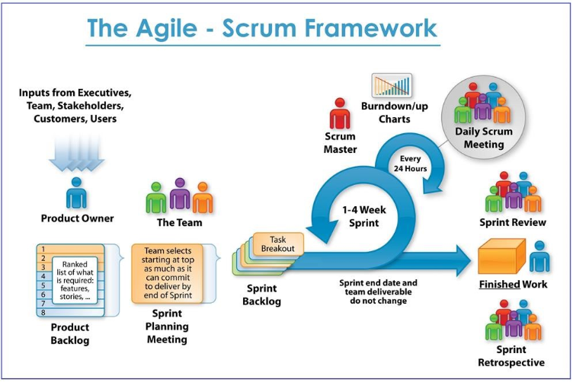
Scrum Process Flow
http://www.etechpulse.com/2015/02/agile-scrum-process-sdlc.html
p 5

Slide 6
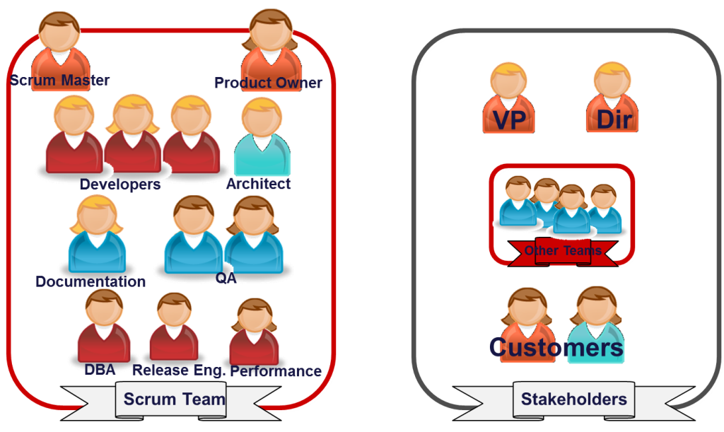
Scrum Roles and Responsibilities
Scrum defines three key roles
Product Owner
Scrum Master
Development Team
Product Owner | Scrum Master | Development Team
One person, not a committee Has authority to make decisions on behalf of the organization Understands the product and business direction Defines the features of the product Manages and prioritizes features and the product backlog Accepts or rejects work results | One person, not a committee Ensures the team is fully functional and productive Ensures the team understands and follows the principles of Scrum Removes impediments to the teams progress Shields the team from outside interference Facilitates Scrum events/meetings Promotes Scrum within the organization | Typically made up of 3 to 9 individuals Cross-functional… No titles or specialized areas of responsibility. There may be specific skill sets, but the team is ultimately responsible for delivering incremental functionality Self-organizing - Team decides how to break up and distribute the work Estimates amount of product backlog that can be delivered in a sprint Demonstrates work results to the Product Owner
p 6

Slide 7
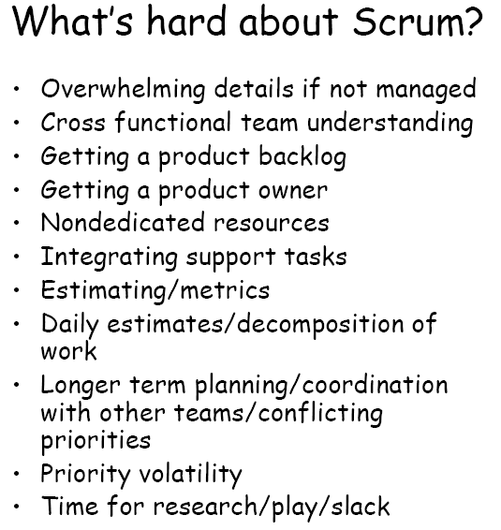
Scrum’s Challenges
Product Owner Challenges
Resisting the temptation to "manage" the team.
Resisting the temptation to add more important work after a sprint is already in progress.
Being willing to make hard choices during the Planning Meeting.
Balancing the interests of competing stakeholders.
Scrum Master Challenges
Resisting assigning work to team members.
Resisting the need to make the decision.
Reminding everyone of the Scrum rules.
Resisting the temptation to tradeoff quality in the face of pressure
p 7

Slide 8
Scrum Adapted to Common Process
Initiation
Planning - Sprint 0
Execution - Sprints 1-n
Determine Product Owner, Scrum Master, and team
Build product backlog (w/ story point estimates)
Sprint planning meeting to determine sprint backlog
Release - Sprint n+1
Closure
Conduct final retrospective
Execute implementation plan
Daily Scrum meetings
Determine non-functional requirements
Project approval and activation
Address architectural needs and environments
Daily Scrum meetings
Burn-down and velocity checks
Conduct sprint review
Conduct retrospective
Refine product backlog (Backlog Grooming)
Deliver training & transition to stakeholders
Release shippable product
Final sprint review
Perform project closure activities
Input from end-users, customers, team, and other stakeholders on key requirements
Develop project charter
Develop Release Plan
p 8
Notes:
Remember – pure Scrum is a cultural change. Many organizations adopting Scrum don’t understand that or cannot effectively make the leap, but want to be “agile” to meet business requirements. Therefore, application of Scrum usually gets modified as part of the journey. This is just a possible representation.

Slide 9
Project Initiation and Kick-off
Initiation
Most companies require formal project selection and initiation processes
Project charters and detailed scope statements can still coincide with Scrum (some do this within “Sprint 0”)
Business requirements include everything from regulatory requirements to regulatory processes and deliverables that must be followed or completed
Don’t forget quality/compliance requirements and the deliverables required for certain projects and industries
Requirements formats, such as use case narratives, can be applied instead of user stories but still work for Scrum

Slide 10
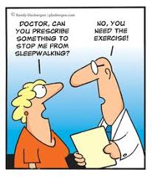
Project Initiation and Kick-off
Initiation
Team Exercise:
Prioritized Backlog

Slide 11
Sprint 0: Planning
Planning - Sprint 0
Usually anywhere from 1-4 weeks prior to first Sprint
“Sprint Zero” is not technically considered Scrum… but, depending on size, complexity, “greenfield” vs. enhancement, new team etc., there is usually some type of prep work required prior to starting Sprint 1 once a formal project selection and/or initiation process has been followed
“Sprint 0” may be a good idea if you need it… use common sense! Other times you can jump right in and start doing development
Key activities typically include:
Team on-boarding, project overview and vision, roles and responsibilities overview
Preparing/ prioritizing backlog by talking to users/customers, story generation, prototyping the UI, and other activities
Release Plan & Scope negotiation
Choosing development platforms
Setting up working development environments, IDE’s, Hardware Software Infrastructure
p 11

Slide 12

Sprint 0: Planning
Planning - Sprint 0
Team Exercises:
Release Planning
Backlog Grooming
p 12

Slide 13
Sprints 1-n: Execution
Execution - Sprints 1-n
Product Backlog Grooming
Reviewed & prioritized by the Product Owner and Scrum Master
Backlog Grooming prior to every Sprint Planning
Sprint Planning Meeting Solidifies Sprint Backlog
Product Owner presents stories for sprint and acceptance criteria
Team validates and clarifies User Stories
Team creates tasks for User Stories
Sprint Execution
Anywhere from 1 – 4 weeks; 2 or 3 is ideal
Daily Standup Meeting
Daily Burndown Chart Reviewed with Team
Product Demonstration
Team demonstrates working software and acceptance stories as “done”
Retrospective
Team reviews achievements and identify key improvements for next sprint
p 13

Slide 14
Sprint Planning Meeting Checklist
Attendees: Product Owner, Team, ScrumMaster/Project Manager
Common Obstacle: Diving into too much detail and design/feature – ID tasks
Key Considerations:
The team always has the final say when it comes to estimating
Every team member should have a vote and/or voice
Dependencies should be minimized, if not prevented entirely
The team should consistently identify any impediments preventing them from completing their work that need to be addressed
Agenda:
Product Owner and team review and clarify each item
Larger stories are broken down as necessary
Team estimates any resulting new stories
Team selects the stories they can complete within the iteration
Team ideally defines the iteration goal or theme
Team breaks each story into tasks and clearly defined acceptance criteria
Team estimates each task, typically in hours
Team members sign up for tasks initially during the iteration
Team may review the workload to make certain it is feasible and balanced
Product Owner agrees with the work that will be completed

Slide 15
Sprint Planning Meeting Checklist
Inputs
Prioritized / Groomed product backlog
Prior Velocity
Outputs
Iteration goal
Acceptance tests
Team member capacity
Schedule Risks
Other known issues/risks
Story tasks
Task estimates

Slide 16
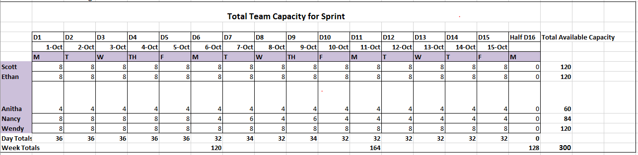
Sprint Review Capacity

Slide 17
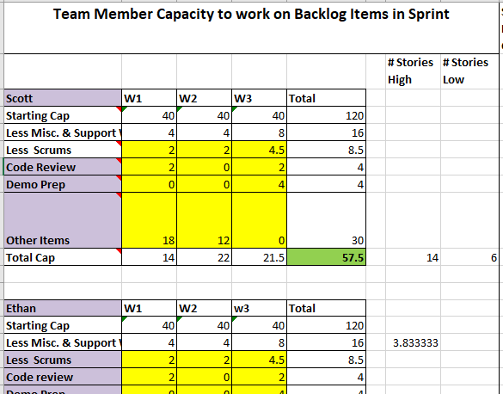
Sprint Review Capacity

Slide 18

Sprints 1-n: Execution
Execution - Sprints 1-n
Team Exercise:
Sprint Planning
p 18

Slide 19
Daily Standup Meeting Checklist
Attendees: Product Owner*, Team, ScrumMaster/Project Manager
Common Obstacles:
All team members not present and/or on time
Non-core team members consume the meeting (Chickens / Stakeholders)
General discussion/tangents
ScrumMaster not providing structure/coaching for team
Agenda:
What have you done since we last met?
What am I committing to complete by our next meeting?
What impediments are you encountering that are preventing you from making forward progress?
Has any work grown larger or smaller now that I have worked on it/looked into it?
Key Considerations:
Only people with work assigned should speak (Pigs Only)
Keep to 15 minutes
Other topics should be addressed outside of the meeting
Team should report progress to team
Note impediments/issues; discuss after the “15th” minute
We do not solve problems, we agree on who will work together to solve and bring back to team.

Slide 20
Daily Standup Meeting Checklist
Inputs
Individual team member’s state of work currently and completed
Outputs
Team communication and understanding of individual and iteration progress
Task status
Critical issues or impediments assigned

Slide 21
Stand Up Rules: https://www.youtube.com/watch?v=Hv8xtMgGGRg
Another Way for Stand Up:
https://www.youtube.com/watch?v=H02BlTXpcto
Is this us?
https://www.youtube.com/watch?v=sLPIU60_NCM

Slide 22
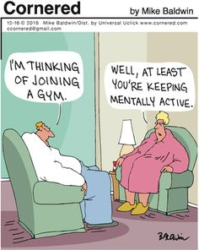
Sprints 1-n: Execution
Execution - Sprints 1-n
Team Exercise:
Sprint 1
Standup
p 22

Slide 23
Sprints 1-n: Execution
Execution - Sprints 1-n
Sprint Review and Product Demonstration
Team demonstrates working software and acceptance stories as “done”
Retrospective
Team reviews achievements and identify key improvements for next sprint
p 23

Slide 24
Sprint Review Meeting Checklist
Attendees: Product Owner, Team, ScrumMaster/Project Manager, Stakeholders
Key Considerations:
Team needs to be comfortable with the pass/fail nature of a Sprint. If ALL items planned for a Sprint are accepted by the Product Owner, the Sprint has passed. Otherwise it has failed.
“Just say no” to Powerpoint slide decks or feature dissertations
Real-time demonstrations are powerful, yet may require time from team to prepare
The Product Owner may decide not to accept certain functionality
Agenda:
Team demonstrates completed functionality to Product Owner and interested Stakeholders
Product Owner Accepts all completed items and identifies any incomplete stories
The ScrumMaster with Team and Product Owner moves and/or splits incomplete stories or backlog items into next iteration or back into product backlog if no longer a priority
ScrumMaster closes out iteration and notes Product Owner acceptance of delivered items
Any open issues/impediments and action items are noted and assigned
Team reviews velocity and burndown chart and declares Successful Sprint

Slide 25
Sprint Review Meeting Checklist
Inputs
Working, tested software
Outputs
Final acceptance of completed functionality
Resolution to any incomplete items
Product backlog updated and prepped
Demonstration scripts/preparation
Pass/Fail Sprint
Time Entries
Work Items Committed

Slide 26
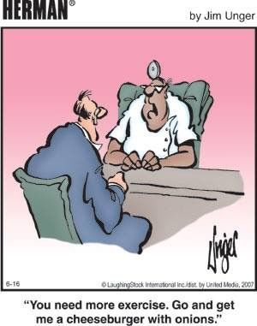
Sprints 1-n: Execution
Execution - Sprints 1-n
Team Exercise:
Sprint 2
Sprint Review & Demo
p 26

Slide 27
Sprint Retrospective Meeting Checklist
Attendees: Product Owner, Team, ScrumMaster/Project Manager
Key Considerations:
Always remember, and remind the team, that retrospectives are intended to focus on the process and not the people
Whoever facilitates should make an effort to ensure all team members participate
We are looking for one area to Improve upon and one area to concentrated on continuing to do.
Agenda:
Team reviews what went well during the last iteration
Team reviews what didn’t go as well or as planned during the last iteration and why
Team identifies the most important items or issues to focus on next iteration
Team notes any additional impediments preventing them from adopting and/or improving their process

Slide 28
Sprint Retrospective Meeting Checklist
Inputs
Details and accomplishments from the prior iteration
Outputs
Prioritized impediments or newly identified stories for action in an upcoming iteration
List of issues or impediments
Things that helped team be successful
Things that slowed us down
Who did a great job?
Agreement on 1 item to improve on in next sprint
Agreement on 1 item to continue to do

Slide 29
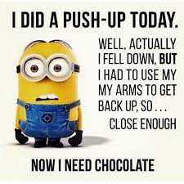
Sprints 1-n: Execution
Execution - Sprints 1-n
Team Exercise:
Sprint Retrospective
p 29

Slide 30
Ceremonies
Event | Description | Key Artifacts
Sprint Planning Meeting | Product Owner presents the stories for the upcoming sprint Team commits to certain stories and develop the detailed task plan to deliver the stories | Sprint Backlog List of tasks to accomplish a story for this sprint; owned by the Team
Daily Standup | Daily 15 minutes meeting where each team member answers 3 questions: What did I accomplish yesterday What will I work on today What impediments are impeding my progress? | Impediments List Sprint Burndown Chart illustrating the team’s progress against a Sprint Goal
Product Demo | Team demonstrates the functioning software (completed stories) to the Product Owner and other stakeholders Product Owner accepts or rejects work | Working Software
Sprint Retrospective | Forum to “Inspect and Adapt” What did we do well? What can be improved? | Improvement areas prioritized based on team input
p 30

Slide 31
Sprint
Release - Sprint n+1
Closure
Training and transition requirements and processes may need additional roles/resources to release the product
Release and closure activities can still be time-boxed and follow Scrum-based processes to achieve final product release requirements for the business
Formal release processes between ITIL and Scrum can be achieved with proper planning

Slide 32
Scrum Adapted to Common Process
Initiation
Planning - Sprint 0
Execution - Sprints 1-n
Determine Product Owner, Scrum Master, and team
Build product backlog (w/ story point estimates)
Sprint planning meeting to determine sprint backlog
Release - Sprint n+1
Closure
Conduct final retrospective
Execute implementation plan
Daily Scrum meetings
Determine non-functional requirements
Project approval and activation
Address architectural needs and environments
Daily Scrum meetings
Burn-down and velocity checks
Conduct sprint review
Conduct retrospective
Refine product backlog (Backlog Grooming)
Deliver training & transition to stakeholders
Release shippable product
Final sprint review
Perform project closure activities
Input from end-users, customers, team, and other stakeholders on key requirements
Develop project charter
Develop Release Plan
p 32
Notes:
Remember – pure Scrum is a cultural change. Many organizations adopting Scrum don’t understand that or cannot effectively make the leap, but want to be “agile” to meet business requirements. Therefore, application of Scrum usually gets modified as part of the journey. This is just a possible representation.

Slide 33
Key Points to the Adapted Process
Adapt the Scrum framework to fit within your company’s project initiation process and process closure process
Scrum is based on dedicated team members. Allocating members across projects and other work disruptions (e.g. production support) will disrupt the effective application of sprints
Many organizations have activities outside of the Scrum process that still need to be addressed, such as integration with ITIL processes
Prior to an official release of the product, but after the code has been considered “done”, an additional sprint may be needed at the end to officially launch the product (solution) into a production environment
A PMBOK-based framework and Scrum can coincide

Slide 34
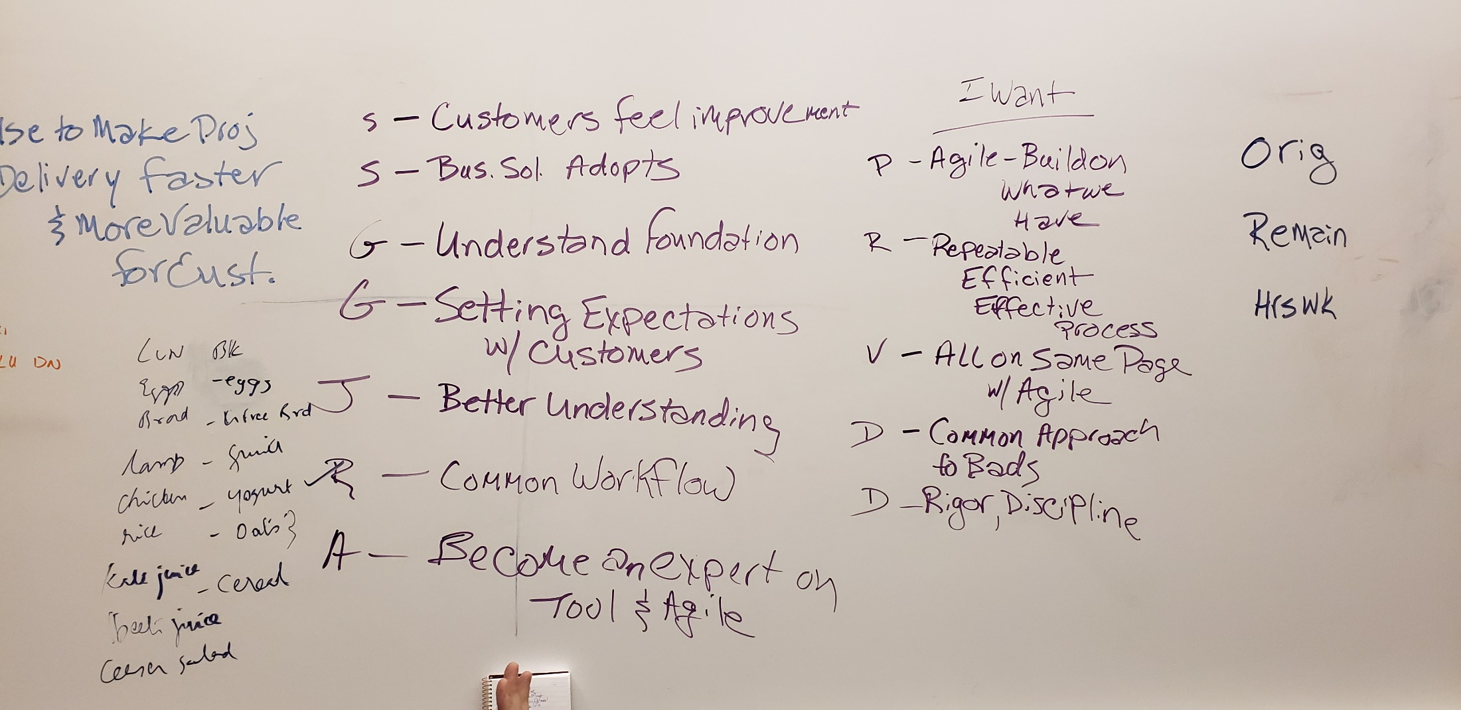

Slide 35
Review What We Wanted
Pradeesh – Build on the Agile that we currently do
Russ – Repeatable Efficient Process
Viktor – All of BADS are on Same Page with Agile
Dan – Common Approach for BADS team
Dan – Instill some rigor and discipline into our process
Spencer – Customers feel an improvement
Spencer – Business Solutions and other teams begin to adopt Agile processes
Gayle – Understand the foundation
Gayle – Setting expectations with customers more effectively
John – Better Understanding of Agile
Rajesh – Common Workflow
Anitha – Become an expert on Agile and Tools

